Slide 1




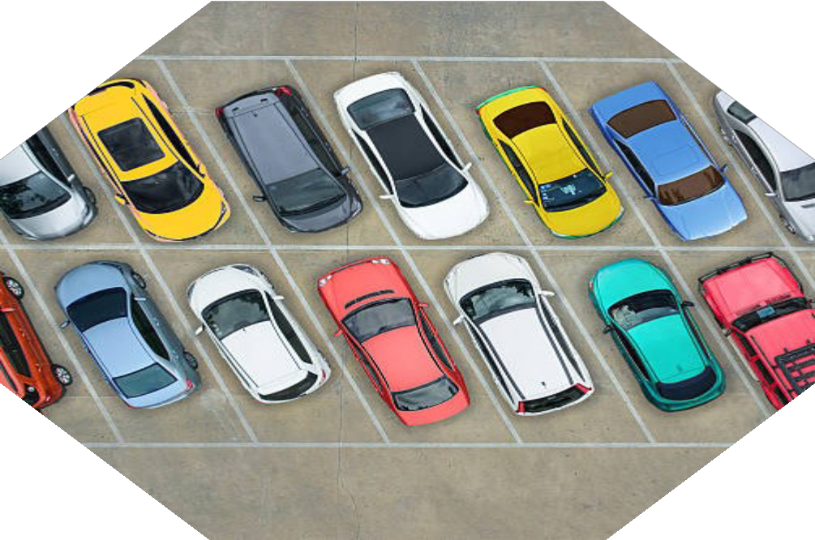
SMART CAR
PARKING
System
Presented by
Ummatun Khatun Rifat Jahan Sumaia Nishat Tasnim Mon

Slide 2

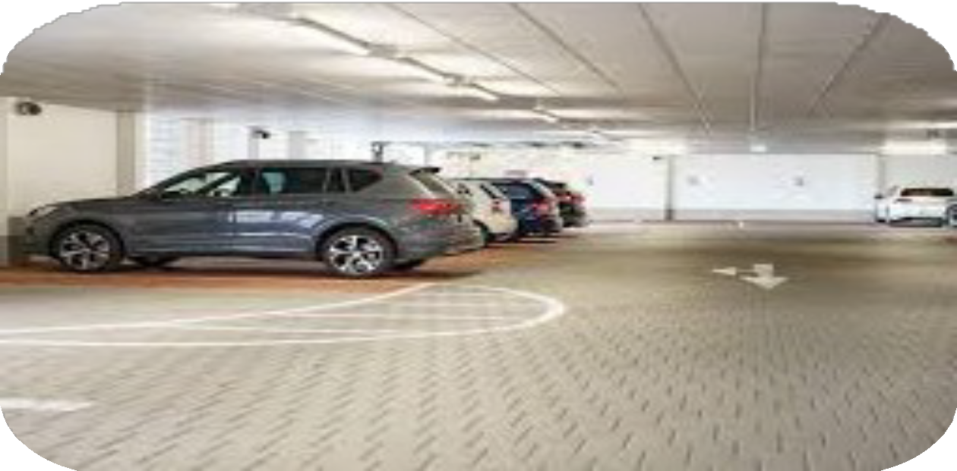
Introduction
The IoT-Based Smart Car Parking System automates parking slot booking and entry/Exit
Uses IR sensors, ESP32, servomotors, and LED. Reduces parking congestion and enhances efficiency

Slide 3

Problem Statement
Urban areas face severe parking shortages due to increasing vehicle numbers.
Traditional parking methods lead to congestion, fuel wastage, and inefficiency.
Lack of real-time monitoring results in ineffective parking space utilization.
Security concerns arise due to unauthorized parking and manual management.

Slide 4

Project Overview
The Smart Car Parking System is an IoT-based solution designed to manage parking slots efficiently using ESP32, IR sensors, servos, and the Blynk platform. It aims to automate parking slot bookings, detect vehicle presence, and control entry/exit gates seamlessly. This system enhances convenience, security, and space optimization.

Slide 5

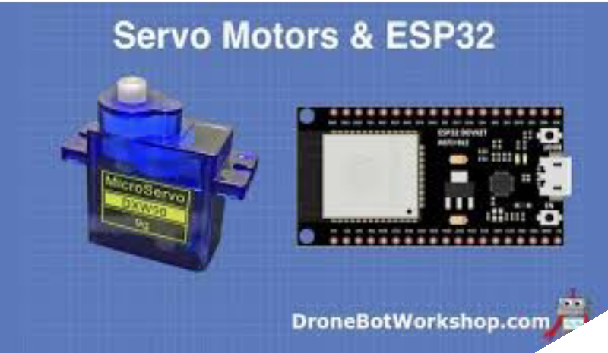
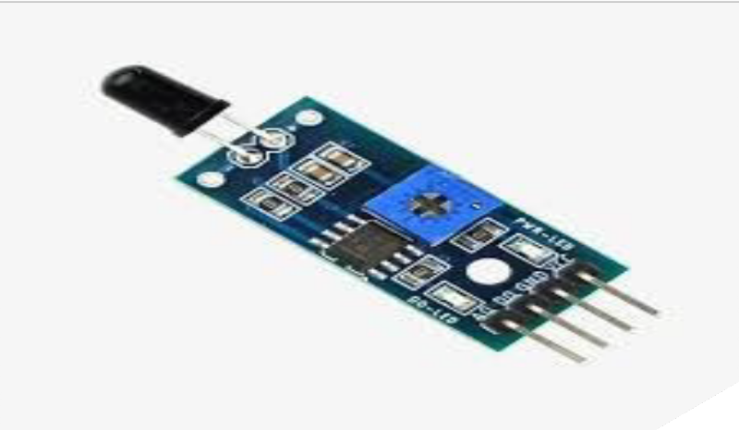
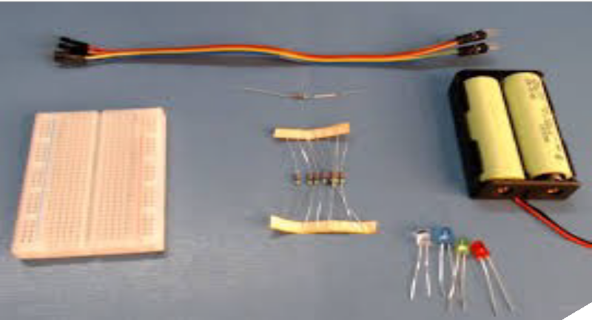
Components
IR Sensors
ESP32 Micro-controller
Servo Motor for Gate Control
Led
Register
Breadboard
Wire

Slide 6

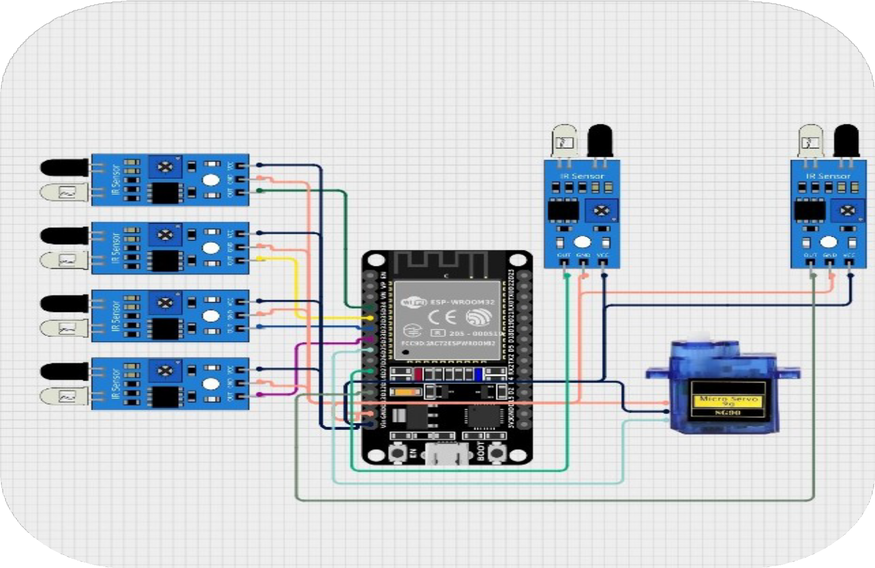
Circuit Diagram
The circuit consists of ESP32, IR sensors, servo motor, and power supply.
Shows real-time parking status and slot availability.

Slide 7

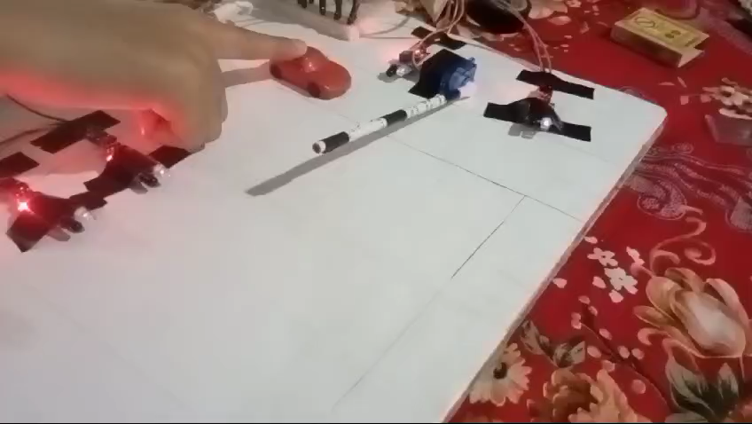

Project Demonstration

Slide 8

Advantages
Reduces Parking Congestion
Optimized space utilization improves parking efficiency.
Smart Urban Solution
A step towards developing intelligent and sustainable cities.
Enhances Security
Saves Time
Eliminates manual parking allocation and reduces search time.
Prevents unauthorized vehicle entry and usage.

Slide 9


Conclusion & Q/A
IoT-based smart parking system improves efficiency and reduces congestion.
Ensures smooth booking and entry/exit process.
Any Questions?

Slide 10


THANK YOU

